Slide 1
AI in Research Series
Workshop starts at 12:02

Slide 2
Choosing an LLM for Your Project
efrén cruz cortés

Slide 3
This workshop is brought to you by:
Northwestern IT Research Computing and Data Services
Need help?
AI, Machine Learning, Data Science
Statistics
Visualization
Data Collection, Cleaning​, Analysis, Management ...
Scraping, Text Analysis, Computing, Reproducibility ...
R, Python, SQL, MATLAB, Stata, SPSS, SAS, etc.
Request a FREE consultation at bit.ly/rcdsconsult.

Slide 4
Logistics
Ask Questions.
Use the chat!! And your mic.
If you know the answer, feel free to respond (we may politely clarify).
If my internet goes out.
Take a 5 minute break, and we will meet back in the same zoom room.

Slide 5
What’s next?
SQL Workshop (Nov 19)
Python Bootcamp (Dec 16)
R Bootcamp (Dec 16)
More AI for Research (2025)
https://www.it.northwestern.edu/departments/it-services-support/research/research-events.html

Slide 6
Warning!
Google Colab sends your data to Google’s servers.
Don’t upload any information you wouldn’t publicly share!
This includes data, code, API keys, people’s names, etc. It is OK to use Google Colab for today’s workshop.

Slide 7





Outline

Slide 8
Language Tasks

Slide 9
What is your task?
The first step in choosing an appropriate LLM is to correctly identify the task you are working on.
Let’s look at some specific examples, before thinking of types of tasks in general.

Slide 10



Named Entity Recognition
Chimpanzees, gorillas, and orangutans have been living for hundreds of thousands of years in the forest, living fantastic lives.
(Jane Goodall)
Great Apes
Time Interval
Place

Slide 11
Named Entity Recognition
Chimpanzees, gorillas, and orangutans have been living for hundreds of thousands of years in the forest, living fantastic lives.
(Jane Goodall)
Great Apes
Time Interval
Place

Slide 12



Sentiment Analysis
Spent the day sharing stories with my grandparents :-)
I’m scared we are losing the sense of community we once had.
Ran into an old friend today. We used to be so close; I miss that.
Another historic building gone. Heartbreaking.
I’m worried about the rising rent. What if we can’t afford it anymore?
I love how we all come together for our Fall celebrations!
Just got back from the street market—so much vibrant energy.
They’re tearing down the park next month. Where will our kids play?

Slide 13
Sentiment Analysis
Ran into an old friend today. We used to be so close; I miss that.
Just got back from the street market—so much vibrant energy.
I’m scared we are losing the sense of community we once had.
Another historic building gone. Heartbreaking.
Spent the day sharing stories with my grandparents :-)
I’m worried about the rising rent. What if we can’t afford it anymore?
They’re tearing down the park next month. Where will our kids play?
I love how we all come together for our Fall celebrations!
Sadness
Joy
Fear

Slide 14












Topic Modeling

Slide 15



Topic Modeling

Slide 16
Summarization

Slide 17
Summarization
“In this series of studies, the authors have corroborated through experiments that the hypothesized law ...”
“Each of these papers studies a different intervention to alleviate the population’s challenge. Paper 1 shows that ...”

Slide 18
Code Generation
I'm giving a presentation on generative AI. I need an example of how an LLM can generate code. Please provide a small snippet of code. You choose the content and the language. Be creative.

Slide 19
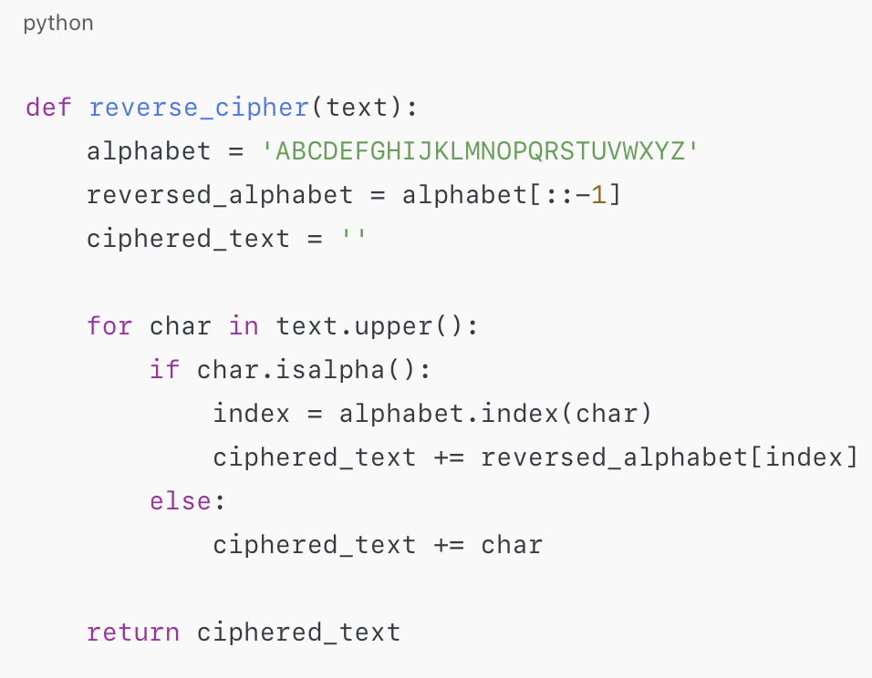
Code Generation
I'm giving a presentation on generative AI. I need an example of how an LLM can generate code. Please provide a small snippet of code. You choose the content and the language. Be creative.

Slide 20



Chatbots

Slide 21
Chatbots

Slide 22

Chatbots

Slide 23
Chatbots

Slide 24
Chatbots

Slide 25
Chatbots

Slide 26
Chatbots

Slide 27
More Tasks
Hugging Face has a great site listing many types of general tasks. You can access it at https://huggingface.co/tasks.

Slide 28
Types of tasks
For our purpose of choosing an LLM, we can broadly (very broadly), divide tasks in two:
Finding structure in the text, as is.
Named entity recognition
Sentiment Analysis
Topic Modeling
etc.
Generating new text.
Summarization
Code Generation
Chatbots
etc.
Your first task will be to identify your task category!

Slide 29
Exercise
(2 minutes)
Write in the chat some details about how you use or plan to use large language models.
Do they fit a type of task we mentioned, or is it something else?

Slide 30
Rationale
LLM models are roughly divided between those that transform text into mathematical representations for further analysis and those that generate new text.
Let’s talk a bit about this!

Slide 31
The Transformer

Slide 32
How do we deal with text data?
Most machine learning algorithms only work with numerical data.
So how do we deal with text?
Convert text into numerical data (vectors).
So as to preserve the original meaning.

Slide 33
“Embedding” Models
Chimpanzees, gorillas, and orangutans have been living for hundreds of thousands of years in the forest, living fantastic lives.
(Jane Goodall)
Gorillas
Chimpanzees
Orangutans
Forest

Slide 34
Example – Topic Modeling
You can embed words, sentences, or full documents!

Slide 35
Example – Topic Modeling
You can embed words, sentences, or full documents!

Slide 36
Example – Topic Modeling
You can embed words, sentences, or full documents!

Slide 37
Example – Topic Modeling
You can embed words, sentences, or full documents!

Slide 38



Example – Topic Modeling
You can embed words, sentences, or full documents!

Slide 39
Example – Topic Modeling
You can embed words, sentences, or full documents!

Slide 40
The Transformer
The transformer architecture is the key element driving LLMs today.
It is a neural network.
Its key development is that words “are aware” of their context.
“This virus is pernicious for my health”
“This virus is pernicious for my computer”
In this example “virus” would have a different vector representation depending on context.

Slide 41
The Transformer
It’s divided in two parts:
Encoder
Decoder
Both encoder and decoder have an embedding step. But that’s just the beginning of many more steps.
Encoder → From text to vector representations.
Decoder → From text to text.

Slide 42
The Transformer
Encoder-only models:
Will help you with the first category of tasks, analyzing text as is.
Decoder-only models:
Will help you with the second category of tasks, generating text.
(There are also models using the full transformer with both encoder and decoder, but by far most models specialize in one task.)

Slide 43
The Transformer
Encoder
Encoder Only
Decoder
Decoder Only

Slide 44
Common Transformer-based Models
Decoder-Only
GPT Series (OpenAI)
Claude (Anthropic) *
Llama (Meta)
Mistral/Mixtral (Mistral AI)
OLMo (Allen Institute)
BLOOM (Big Science / HF)
Gemma (Google)
Encoder-Only
BERT
RoBERTa
OpenAI text-embeddings
Ada (older)
Encoder-Decoder
Gemini (Google) *
Phi-3 Vision (Microsoft)
T5
BART
* I couldn’t find official documentation but I’m pretty sure.

Slide 45
Exercise
Case Example 1
You’re investigating how narrative elements in educational materials influence responses by young audiences. For example, plot devices, literary styles, character traits, etc.
Your LLM must create short educational stories varying across all these elements.
What type of model is best suited for this task?

Slide 46
Exercise
Case Example 2
You are tracing the similarity of song lyrics across different musical genres over the years. Your dataset contains thousands of songs and spans several decades. Your similarity is a number between 0 and 1.
What type of model is best suited for this task?

Slide 47
Where Do I Find LLMs?

Slide 48
Open-source vs Proprietary
Most models can be downloaded and used locally.
Some models can only be used through an online interface or an API.
GPT
Claude
Gemini

Slide 49
Where do I find these models?
Let’s start with the big three proprietary ones:
GPT Series
OpenAI website
Microsoft Copilot (private)
Azure version (private)
Claude
Anthropic website
Gemini
Google

Slide 50


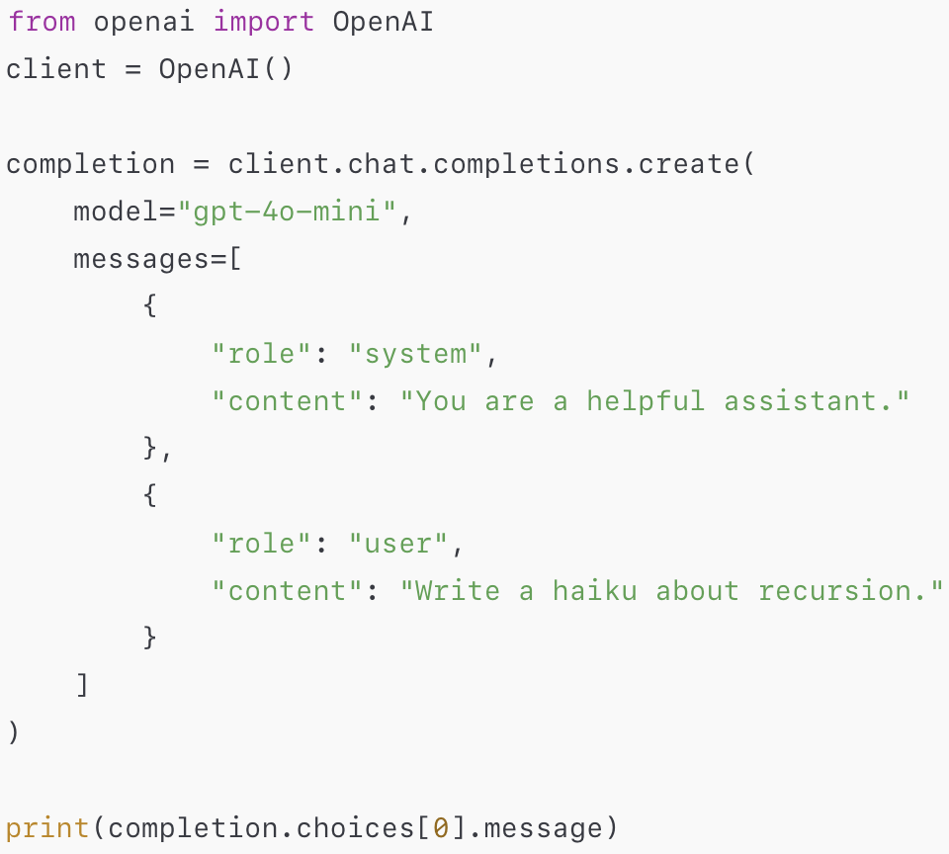
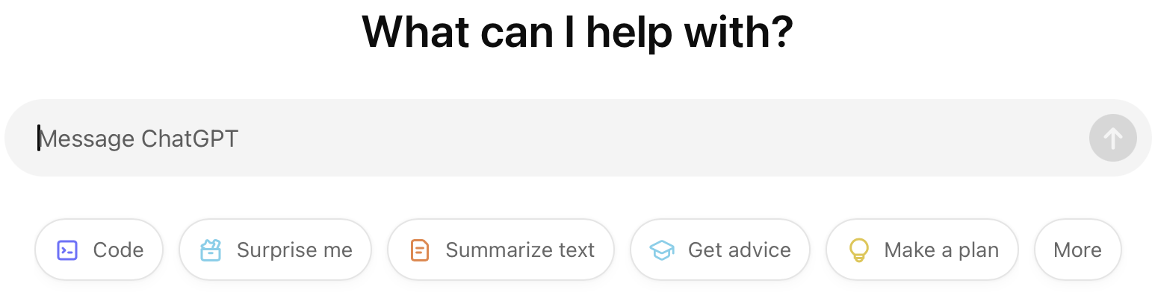
Where do I find these models?
openai.com
Python API
chatgpt.com

Slide 51

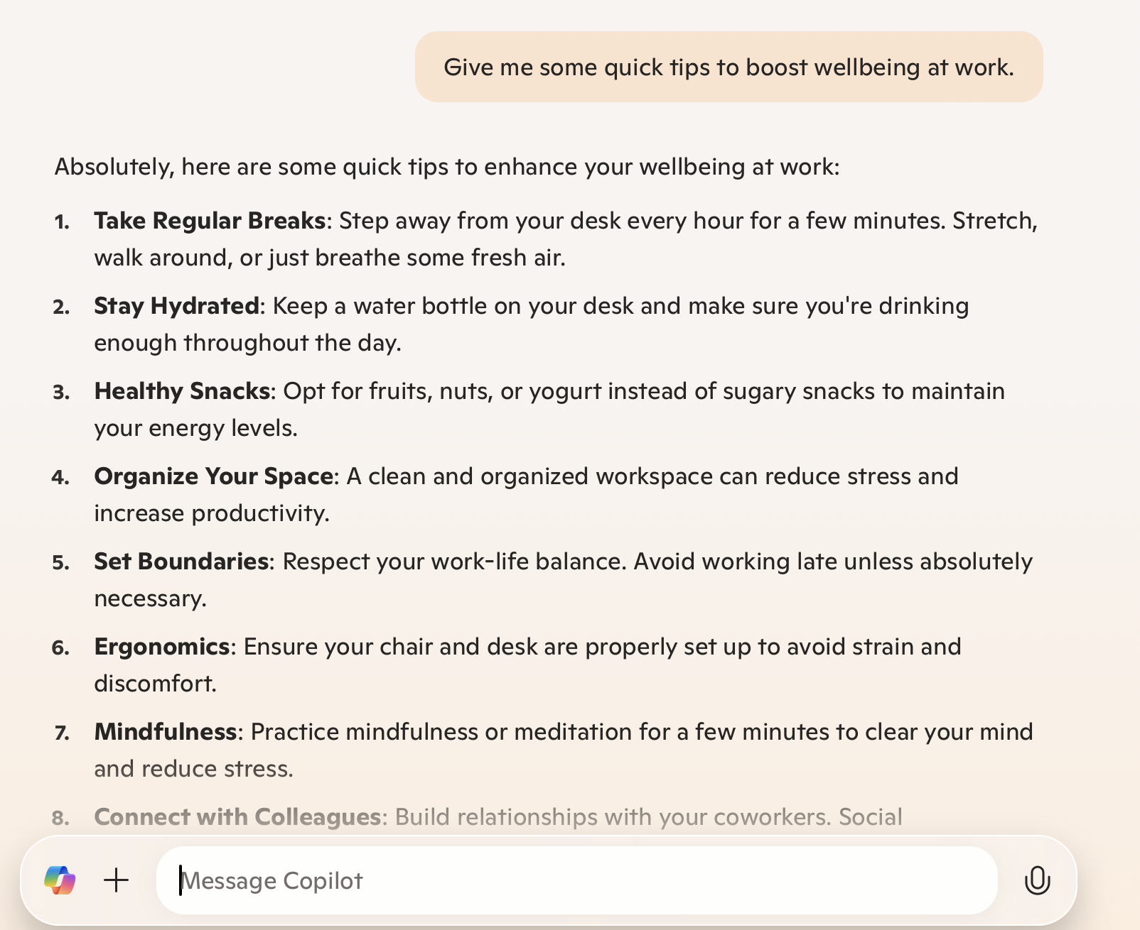
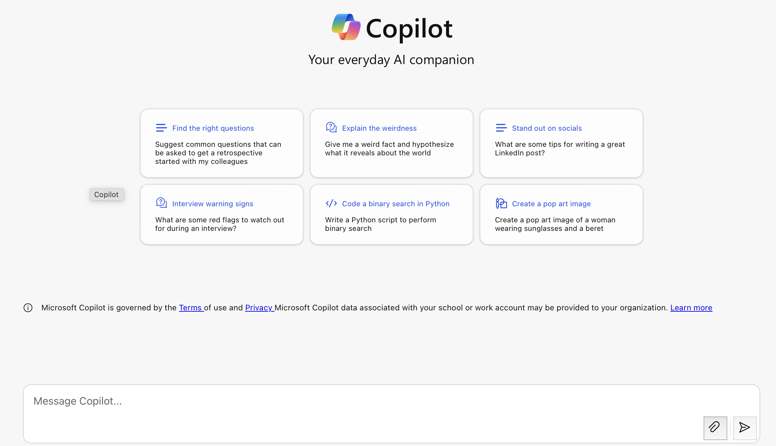
Where do I find these models?
copilot.microsfot.com
copilot.cloud.microsoft
Access through NU
Free Version

Slide 52
A Note on Microsoft Copilot
Northwestern has given us access to additional content from Microsoft Copilot. In particular, if you are logged in with your university credentials, Copilot will respect your privacy, and the privacy of your data. More on privacy soon.

Slide 53

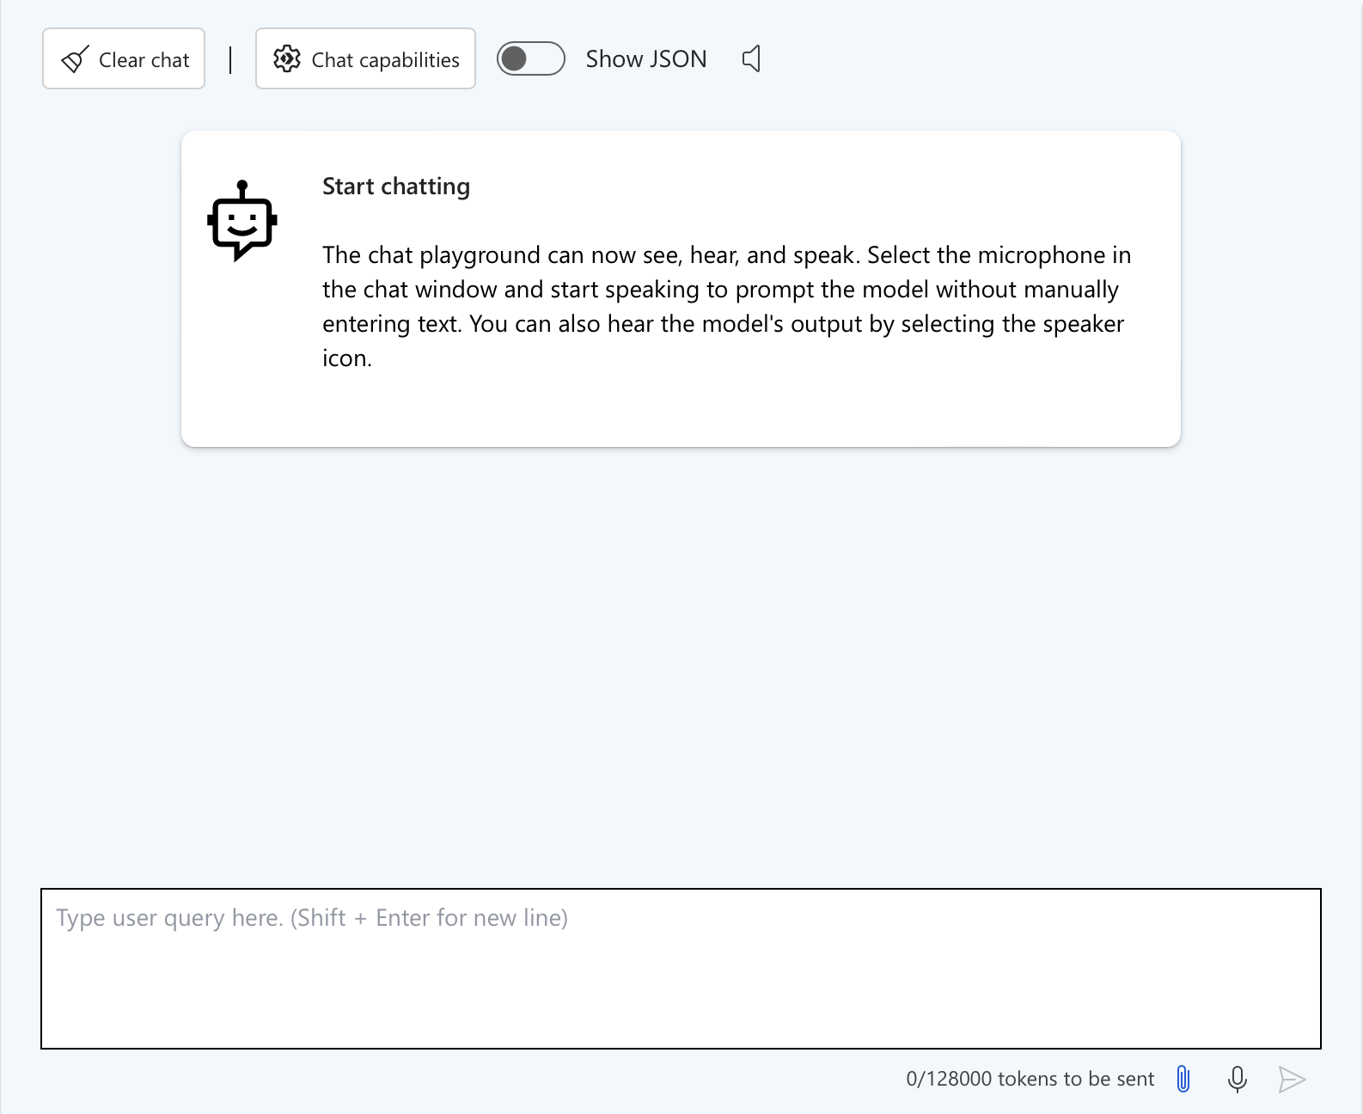
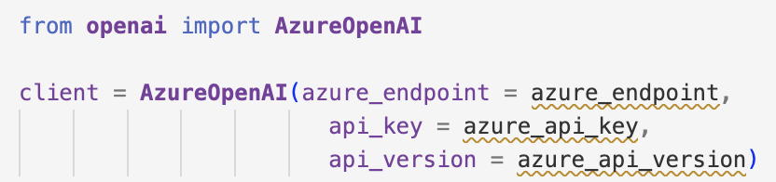
Where do I find these models?
ai.azure.com
Playground
Python API

Slide 54
A Note on Azure
Azure is the name of Microsoft Cloud Services.
You can use LLMs through Azure (including GPT models), but they have a cost.
The advantage is that your data is safe in Azure, and it is not shared with any third party.
Even when using GPT models, your data does not go to OpenAI.

Slide 55
GPT Series
If you are going to use a GPT model from OpenAI. We recommend you use the Microsoft Copilot or Azure versions.

Slide 56

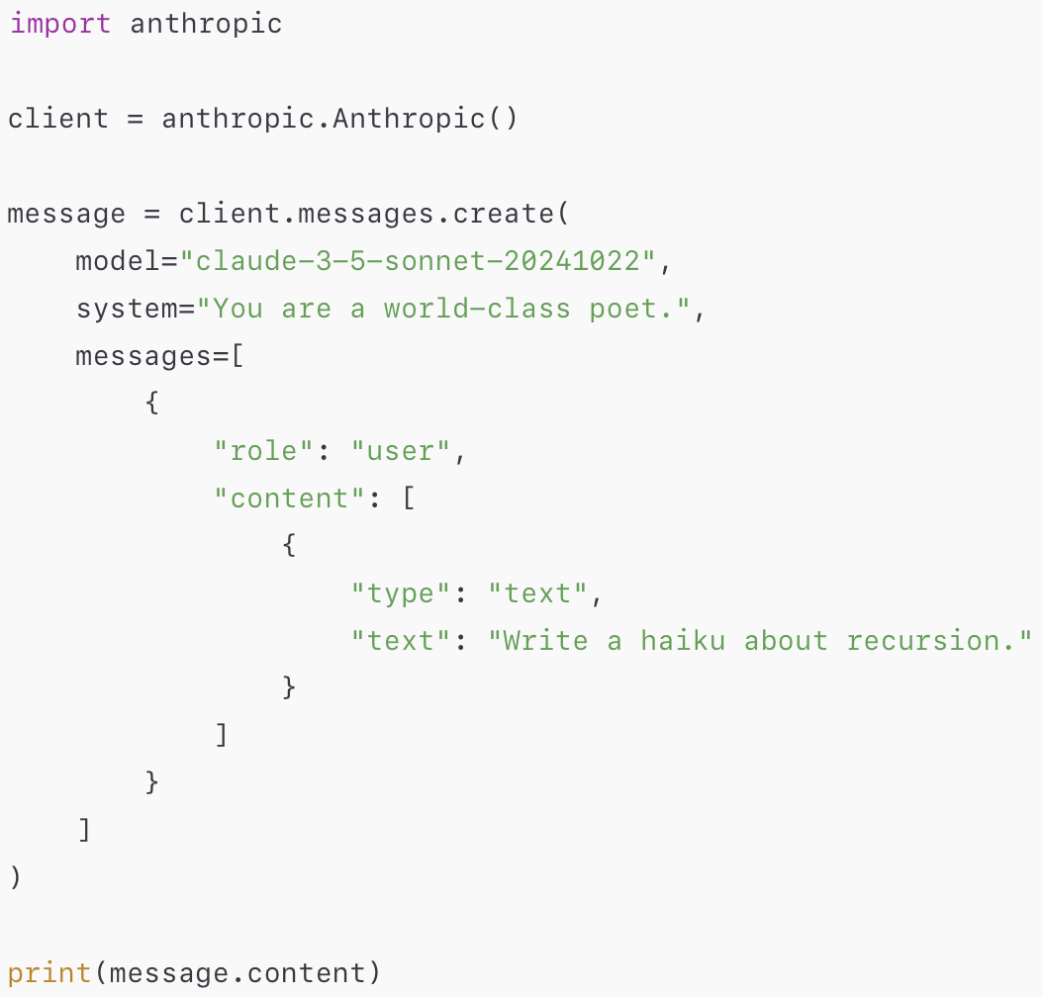
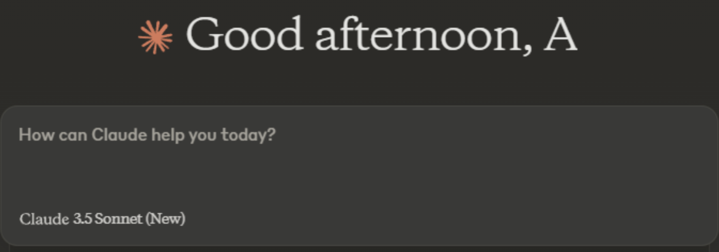
Where do I find these models?
anthropic.com
Python API
claude.ai

Slide 57

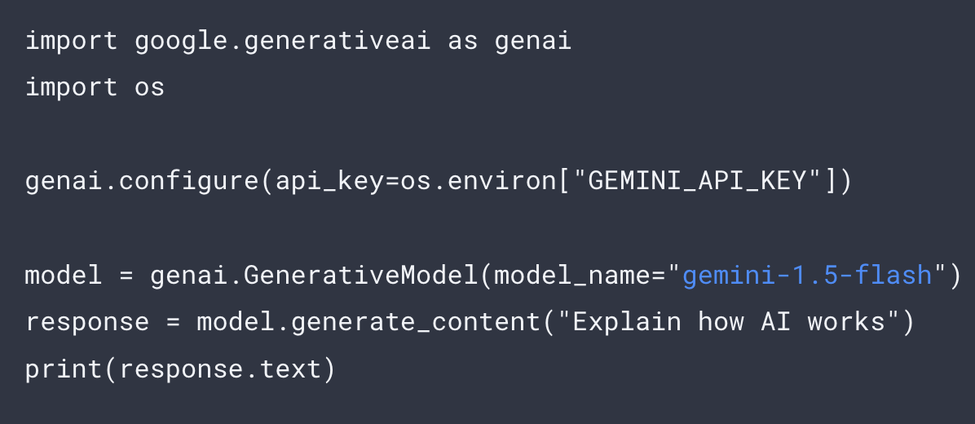
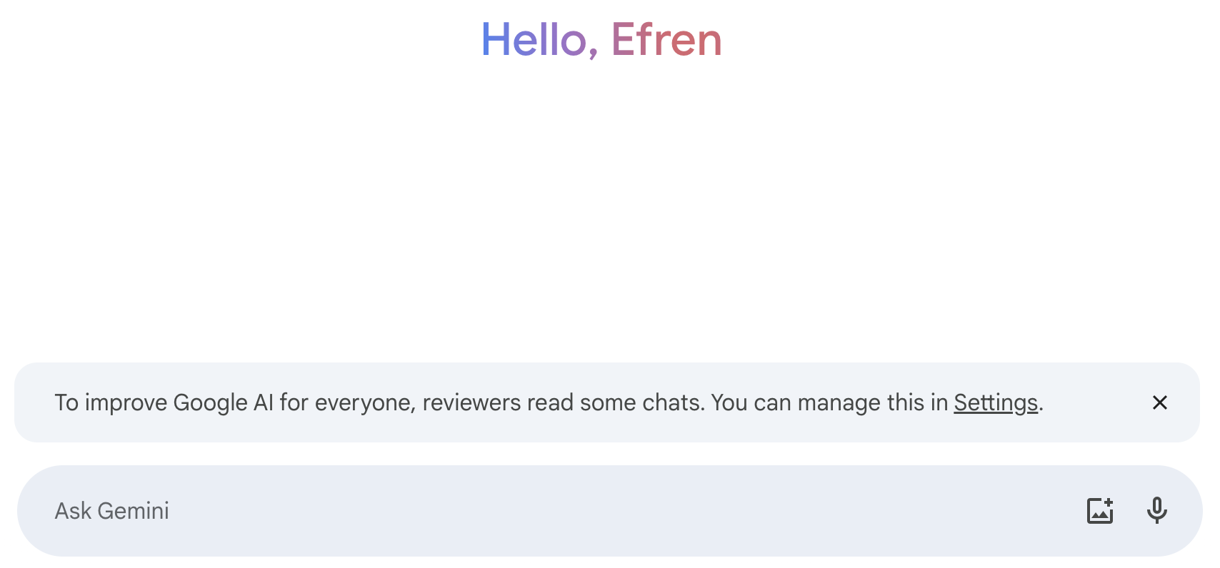
Where do I find these models?
gemini.google.com
Python API
gemini.google.com
Free version, or

Slide 58



What about open-source models?
You can download models from many places. Major ones are:
Hugging Face
Ollama
LMStudio

Slide 59
Comparison
Ollama
Easier starting point.
Ollama library easy to use.
Fewer Models.
Models are generally trustworthy.
Hugging Face
Transformers library more developed.
Larger community.
Many, many, many more models!
Not all models are tested for safety.
LMStudio
Chat only.
Not all models are tested for safety.

Slide 60
Which one to choose?
It depends on your expertise and goals.
If you have some coding experience but will not be doing a lot of machine learning, you may want to start with Ollama.
If you have some machine learning experience and are familiar with pytorch or tensorflow, you may want to use Hugging Face.
If you just want the chat functionality and don’t want to do any coding whatsoever, you may want to start with LMStudio.

Slide 61
Security Considerations
Apparently, some models in Hugging Face contained viruses 😱
This is because anyone can upload to HF.
Only download models from trusted developers / organizations!
The models in these slides are from trusted organizations 👍🏽
There are also safe model formats
.safetensors
.GGUF

Slide 62
What are the steps?
Proprietary, through API
Get API key.
Import appropriate python library.
Open-source
Ollama: Download Ollama, import ollama python library.
Hugging Face: Import transformers + pytorch / tensorflow python libraries.
LMStudio: Download LMStudio.

Slide 63
Other Considerations

Slide 64
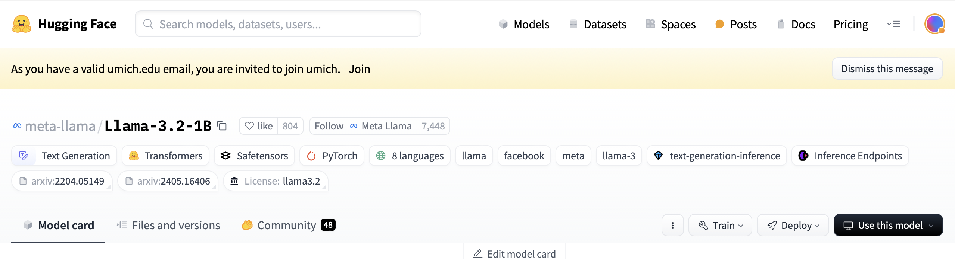
Legal Considerations
Some models have restrictions on their use (attribution, non-commercial, etc.).
Just make sure you look at their licenses. You can find them on their Hugging Face site or (for proprietary ones) in their respective websites.

Slide 65
Privacy Considerations
It is very important that you choose your LLM carefully if you have privacy limitations, since many systems (like ChatGPT) collect your data so they can use it later.
If your data is restricted or sensitive in any way, you should use systems that are compliant.

Slide 66
Privacy Considerations
With your university credentials, NU gives us access to and recommends the use Microsoft Copilot, which respects privacy (when you are logged in).
For more, please visit:
https://www.it.northwestern.edu/about/policies/guidance-on-the-use-of-generative-ai.html

Slide 67
Computational Considerations
Model size can be an indication of quality improvement, BUT, it is not as crucial as you may think.
Many improvements are due to better data and better architectures, NOT to larger data and larger models.
There is a diminishing returns phenomenon in LLMs: the more and more data and model parameters we add, the less impressive their improvement.

Slide 68
Computational Considerations
Models range in size.
A few billion parameters → A few gigabytes, fits in your computer.
Hundreds of billions of parameters → Hundreds of gigabytes, barely fits in some of your computers (storage), but likely not enough memory to run.
When starting, no need to go for the flashiest, largest model out there. Pick a small-medium model as you test and develop.

Slide 69
Domain Considerations
Many famous LLMs are “foundation models”, meaning they are trained using data from different domains and as generalists, to perform a wide variety of tasks.
You may have a more specific domain and task in mind.
Example: medical data, PICO detection (population, intervention, comparison, outcome).
In this case, you may want to use a fine-tuned model appropriate for your domain.

Slide 70
Domain Considerations
For downloadable models, there are many
codeLlama
MedPaLM
bioBERT
sciBERT
NASA Science LLMs
etc.
For Proprietary models, you need to access them through a paid service
GPTs (some are fine-tuned, some are customized)

Slide 71
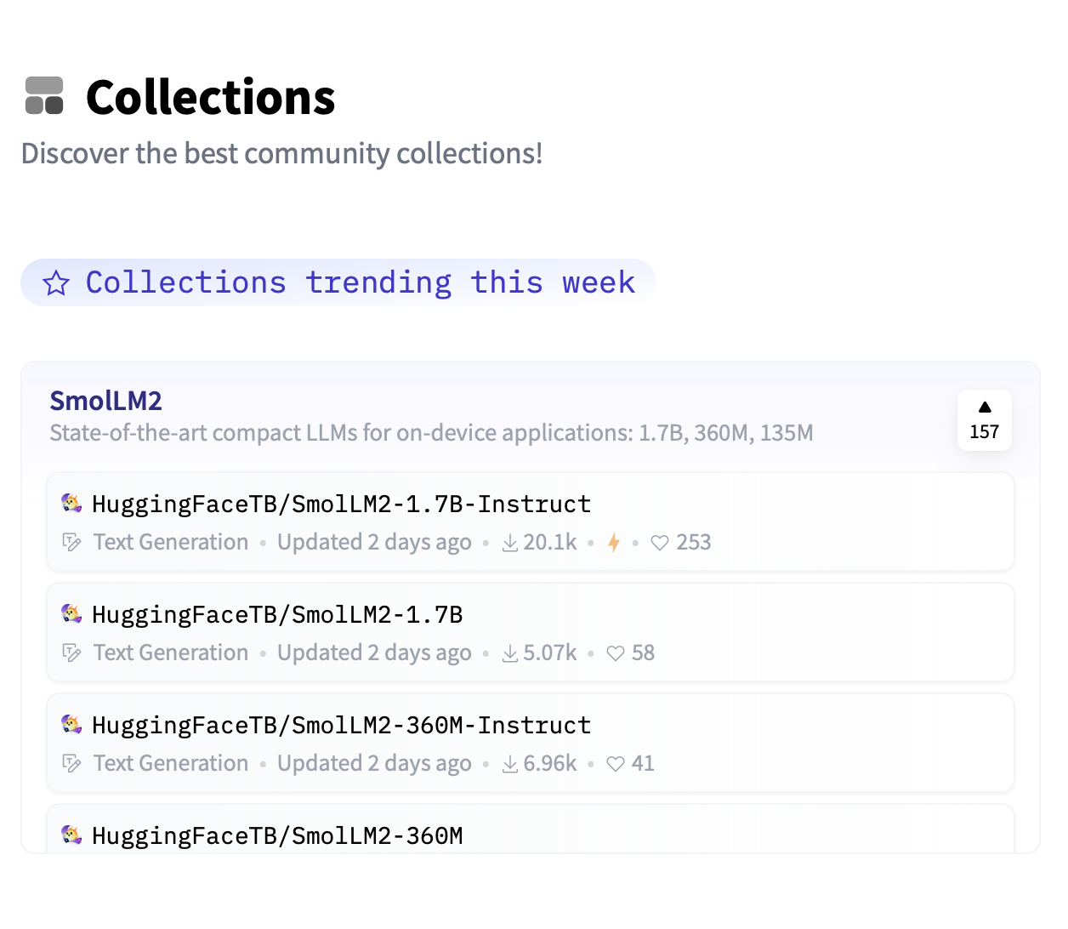
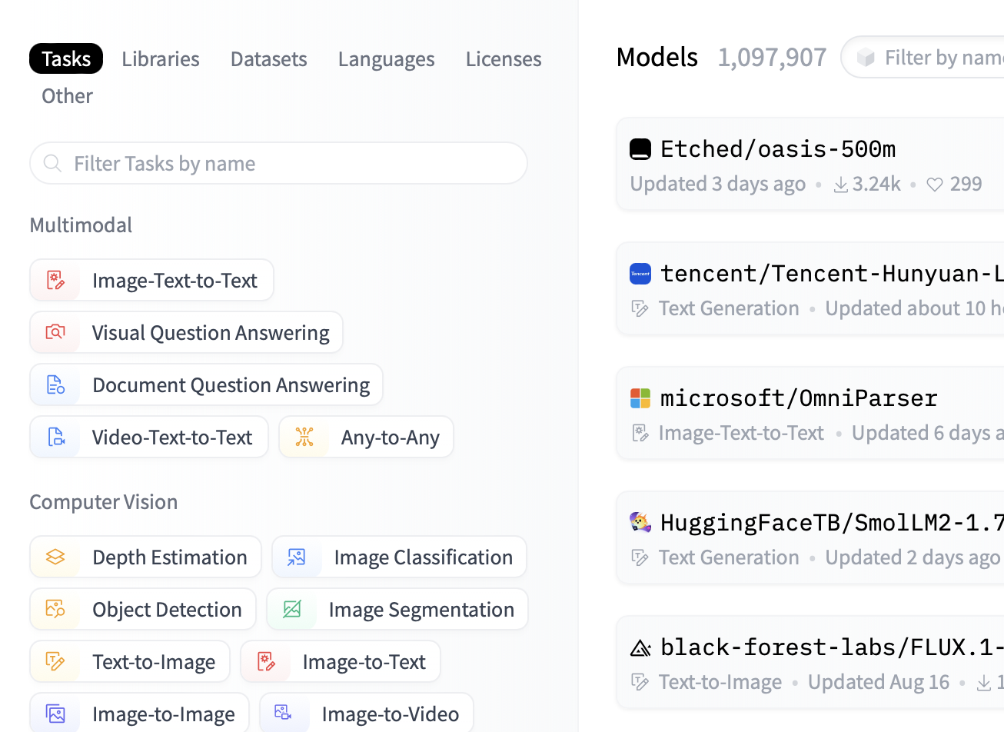
Domain Considerations
While for most purposes you won’t need fine-tuned models. You can still explore what’s out there. The best way to find them is through Hugging Face: “Collections”, and “Models”.
Remember to only get models from reputable agents (universities, scientific organizations, etc.).

Slide 72
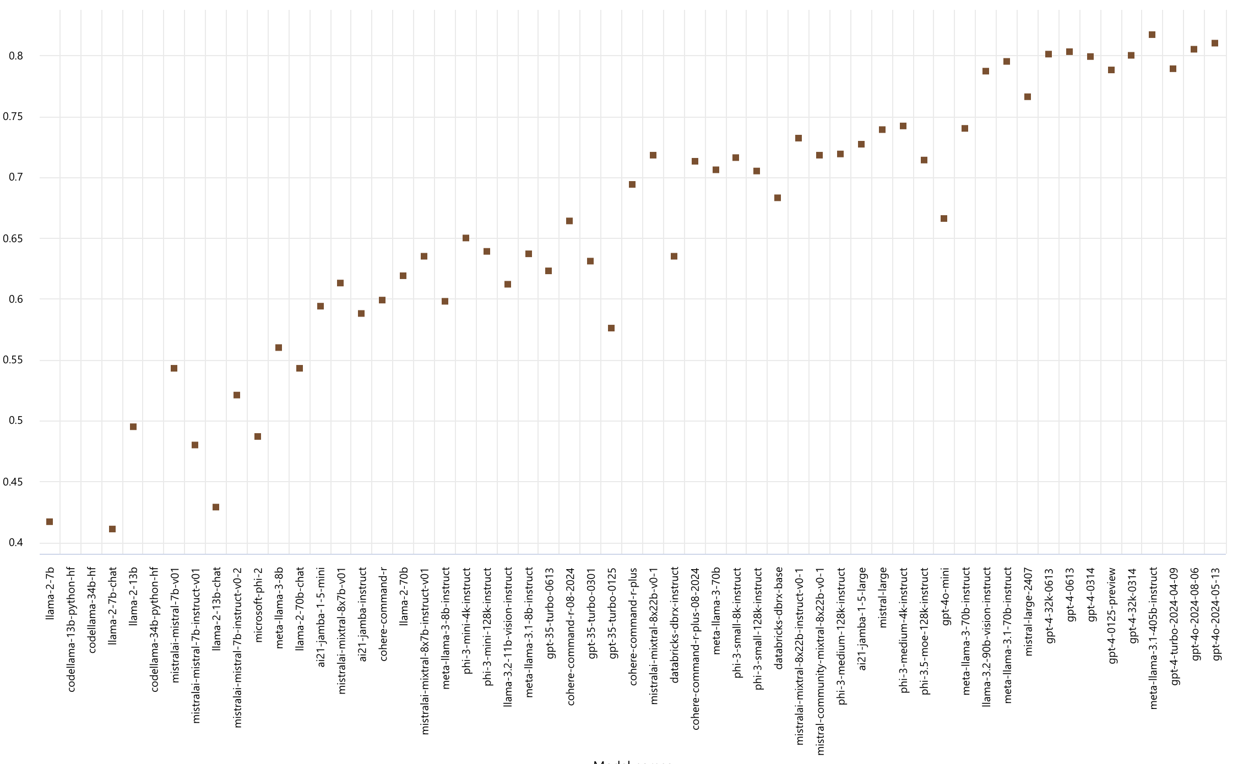
Domain Considerations
You may also use models which are not fine-tuned, but nonetheless exhibit better performance in a particular capability.
There are established benchmarks for different domains. Azure has a good graph comparing different models across different benchmark tests, https://ai.azure.com/explore/benchmarks.
Model performance comparison of different LLMs. Performance taken w.r.t “Humanities” related content. From Azure.
Accuracy Score

Slide 73

Ethical Considerations
Biases
Most LLMs have been heavily fine-tuned to avoid social biases (this was done with the labor of many humans tagging offensive and harmful content). At this point they are decent at their job, but may still fall short on occasion. You may want to choose according to which performs better in this domain.

Slide 74

Ethical Considerations
Data Collection
Many LLMs were trained using data scraped from the internet. In some cases (OK, most cases), these data were obtained in an unethical way (against a website’s policies, no attribution to creators, etc.). This includes well-known and currently in use models.

Slide 75

Ethical Considerations
Environmental Impact
The environmental impact of LLMs (and Generative AI in general) is very high. Some companies put more effort into alleviating these effects than others. Some are also more open than others.

Slide 76
Ethical Considerations
If you want to learn more about ethical considerations for AI systems in general, stay tuned! We’ll give workshops on this in the future.

Slide 77
Recap

Slide 78
Choosing your LLM
What task are you performing?
Do you want to do it in the cloud (Azure, OpenAI, Anthropic), or in your computer?
What are your storage/computational capabilities?
What license do you need?
Do you need a domain specific, fine-tuned LLM?
Was the LLM created following ethical guidelines?

Slide 79





Example

Slide 80
Example
Is it a decoder?

Slide 81
Example
Is it a decoder?
Decoders
Encoders
Encoder-Decoders

Slide 82
Example
Decoders

Slide 83
Example
Can I download the model?
Decoders

Slide 84
Example
Can I download the model?
No
Yes

Slide 85
Example
Can I download the model?
Yes

Slide 86
Example
Is it specific for coding?
Yes

Slide 87
Example
Is it specific for coding?
No
Yes - CodeLlama

Slide 88
Example
Yes - CodeLlama

Slide 89
Example
Does it fit in my computer?
Yes - CodeLlama
7B
13B
34B
70B

Slide 90
Example
Does it fit in my computer?
Yes
No
7B
13B
34B
70B

Slide 91
Example
Does it fit in my computer?
Yes
7B
13B

Slide 92
Example
CodeLlama
Decoder 👍🏽
Downloadable 👍🏽
Code-specific 👍🏽
Fits in my computer 👍🏽
7B
13B

Slide 93
Questions?

Slide 94
Thank you!

